Slide 1
Linear algebra for data analysis
Johan Westerhuis
Biosystems Data Analysis (BDA)
SILS \ UvA

Slide 2
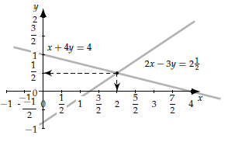

Back to the Math syllabus: Linear Algebra
System of linear equations
Ax = b
Ax = 0
Null space, column space, row space
rank
inverse
$$\begin{matrix}2x−3y=2.5 \\ x+4y=4\end{matrix}$$

Slide 3
Learning goals of today
Understand the concepts column space, Null space, rank, etc related to measured data sets.
Understand the difference between samples
Are there groups or are all samples replicates of each other?
Understand the difference between variables
What is the biological relationship between the variables
What is the correlation between variables
What is the relationship between variables and the response?
Variable (metabolites / genes)
Response (Y)
Data (X)
Samples

Slide 4
Starring:
X: data matrix (I x J) e.g. Omics information
I samples
J variables
Things you know of a new sample
x_{.j}: j^{th} column of X
j^{th} variable measured for all I samples
x_{i.}: i^{th} row of X
All J variables measured for sample i
x_{ij}: single measurement of variable j for sample i
y: phenotypic property (I x 1)
Response, expensive
Sometimes multiple responses: Y (I x K)
J
I
I
J
K
I
I
Notes:
Linear algebra for data matrices and vectors
To understand properties of data analysis methods.

Slide 5






Linear Algebra: Notation
Scalar: $y_{i}$ (italic regular)
Vector: $y$(I rows); $y$ = [$y_{1} y_{2} y_{i}$… $y_{I}$]^{T}, for i = 1:I bold
Matrix: X(I rows x J columns); capital bold
x_{ij} is element at position row i, column j in X
y^{T} = transpose of y
X^{T} = transpose of X
X⁻¹ = inverse of X
Youtube: The essence of linear algebra (3Blue1Brown)
- chapters 1, 2, 3, 4, 6, 7
$$y_{i}=\left[7.2134\right]$$
$$y=\left[\begin{matrix}1 \\ 2 \\ 5\end{matrix}\right]$$
$$X=\left[\begin{matrix}1 & 3 & 4 \\ 3 & 2 & 5\end{matrix}\right]$$
$$y^{T}=\left[\begin{matrix}1 & 2 & 5\end{matrix}\right]$$
$$X^{T}=\left[\begin{matrix}1 & 3 \\ 3 & 2 \\ 4 & 5\end{matrix}\right]$$
Notes:
maybe confusing with the Calibri vs Math typesetting – matrix letters are sometimes italics (in maths typesetting) and sometimes not (like here), same for the superscript T (although there it’s not confusing)

Slide 6

Regression equation / Linear model
J metabolites measured of I subjects (X) to predict complex phenotypic property (y). Prediction error (residual) e.
$y_{i}=x_{i,1}∗b_{1}+x_{i,2}∗b_{2}+ …+e_{i}$
$y_{i}=\sum_{j=1}^{J}{x_{i,j}b_{j}+e_{i}}$
$y=Xb+e$
b^{T}
y
J
e
X
I
Notes:
Indicate x, y1, b1 etc to make y1, residual e1

Slide 7
Vectors y, e, b, directions in space
Vectors are a column of numbers representing a direction from the origin to a point in space
The numbers define the direction and lengths of the vector
Vectors will always be represented as a column
y: (Ix1) contains response value for all I subjects
e: (Ix1) contains residual value for all I subjects
b: (Jx1) contains coefficient for each feature
b^{T}: “b transpose”, (1 x J) is a row vector
I
I
J
J

Slide 8




Vector: Point in space
A scalar (e.g. 3) represents a point on a 1-dimensional space (line) in a known direction with a given unit (e.g. meter).
A vector (e.g. [3, 2.5]) represents a direction point in a 2-dimensional space (plane)
Each dimension can have its own unit (meter, kg)
A vector (e.g. [3, 2.5, 2.1]) represents a point in a 3-dimensional space
…
0
x₁
$$x=\left[3.0\right]$$
x₂
$$x=\left[\begin{matrix}3.0 \\ 2.5\end{matrix}\right]$$
0
x₁
x₂
$$x_{1}=\left[\begin{matrix}3.0 \\ 2.5 \\ 2.1\end{matrix}\right]$$
x₃
x₁
$$x_{2}=\left[\begin{matrix}2.0 \\ 3.5 \\ 1.1\end{matrix}\right]$$
0

Slide 9
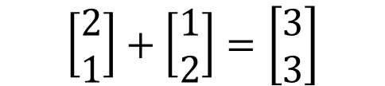
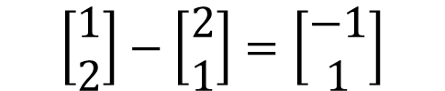
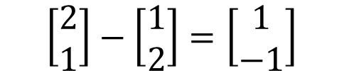
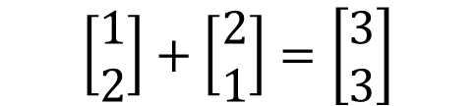
Adding and subtracting vectors in space
Adding vectors
x₂
$$\left[\begin{matrix}2 \\ 1\end{matrix}\right]+\left[\begin{matrix}1 \\ 2\end{matrix}\right]=\left[\begin{matrix}3 \\ 3\end{matrix}\right]$$
$$\left[\begin{matrix}1 \\ 2\end{matrix}\right]+\left[\begin{matrix}2 \\ 1\end{matrix}\right]=\left[\begin{matrix}3 \\ 3\end{matrix}\right]$$
0
x₁
Subtracting vectors
x₂
$$\left[\begin{matrix}2 \\ 1\end{matrix}\right]−\left[\begin{matrix}1 \\ 2\end{matrix}\right]=\left[\begin{matrix}1 \\ −1\end{matrix}\right]$$
$$\left[\begin{matrix}1 \\ 2\end{matrix}\right]−\left[\begin{matrix}2 \\ 1\end{matrix}\right]=\left[\begin{matrix}−1 \\ 1\end{matrix}\right]$$
x₁
0
Notes:
Indicate yellow – blue = red vector, blue - yellow

Slide 10



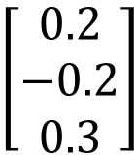





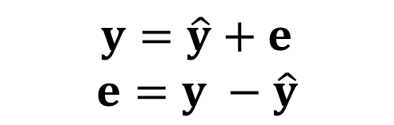


Adding / subtracting vectors in data analysis
$y$ will be predicted from X
The prediction is called $\hat{y}$
The part not predicted is residual e
Adding / subtracting vectors can ONLY be done if they have the same size!
Mean centering:
The variation between values is often represented by their mean-centered value.
The mean of the vector is subtracted from all elements.
$$y=\hat{y}+e$$
$$e=y −\hat{y}$$
$$\left[\begin{matrix}1 \\ 3 \\ 5\end{matrix}\right]$$
$$\left[\begin{matrix}0.8 \\ 3.2 \\ 4.7\end{matrix}\right]$$
$$\left[\begin{matrix}0.2 \\ −0.2 \\ 0.3\end{matrix}\right]$$
$$=$$
$$+$$
$$\left[\begin{matrix}1 \\ 3 \\ 5\end{matrix}\right]$$
$$\left[\begin{matrix}3 \\ 3 \\ 3\end{matrix}\right]$$
$$\left[\begin{matrix}−2 \\ 0 \\ 2\end{matrix}\right]$$
$$−$$
$$=$$
Notes:
Examples of addition / subtraction
Sum of squares:

Slide 11

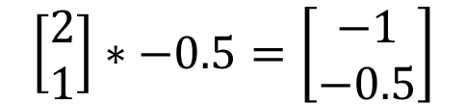
Multiplying vectors with a constant
x₂
$$\left[\begin{matrix}2 \\ 1\end{matrix}\right]∗2=\left[\begin{matrix}4 \\ 2\end{matrix}\right]$$
$$\left[\begin{matrix}2 \\ 1\end{matrix}\right]∗−0.5=\left[\begin{matrix}−1 \\ −0.5\end{matrix}\right]$$
x₁
0
Notes:
Indicate all these vectors are in the same direction

Slide 12
Data matrix X:
X: Data Matrix
I rows (i = 1,…,I)
Each row x_{i.}^{T} contains all J features for row i
We call these: samples, subjects, individuals, …
e.g. [ 5 g/l, 7 mmol/cm³, 1103 counts, … ]
J columns (j = 1, …, J)
Each column x_{.j} contains feature j for all I subjects
We call these:
Features: unknown identity
Variables: (metabolites, genes, …)
Factors: experimental setting (categorical)
Cofactors: additional info on samples (quantitative)
I
J
I
J
I

Slide 13

Matrix: Multiple points in space
A 3 x 2 matrix represents 3 points on a 2-dimensional space (plane)
The same matrix can also be represented as 2 points in a 3-dimensional space.
Dimensions become meaningful when you add their meanings:
Samples, time points, replicates
Variables, metabolites, peak-areas
x₂
$$\left[\begin{matrix}3 & 1 \\ 2 & 1 \\ 1 & 1\end{matrix}\right]$$
0
x₁
x₂
x₃
x₁
0
Notes:
Rows are samples, columns are variables / features

Slide 14
Matrix: row-space, column-space
J
X
I
A matrix X (I x J), represents
I rows of each J values
I points in R^{J} (J-dimensional space)
Row-space (R^{J}), a row has J values
Red lines represent the J dimensions
Blue dots represent I subjects
J columns of each I values
J points in R^{I} (I-dimensional space)
Column-space (R^{I}) a column has I values
Blue lines represent the I dimensions
Red dots represent the J features
Row space (R^{J})
X₂
X_{J}
X₃
X₁
Column space (R^{I})
X₂
X_{I}
X₃
X₁
Notes:
Each row has J values, so lives in Jth dimensional space

Slide 15
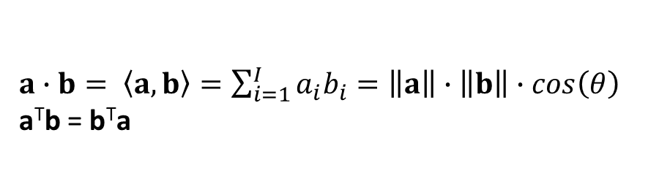




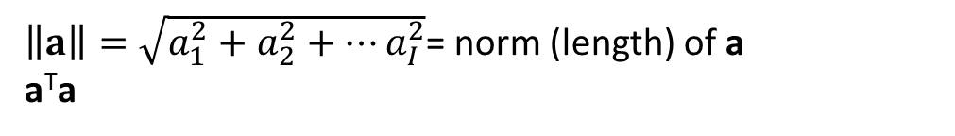

Dot product (inner product)
$a∙b= \left\langle a,b\right\rangle =\sum_{i=1}^{I}{a_{i}b_{i}}=\left\|a\right\|$ $∙\left\|b\right\|∙cos\left(θ\right)$
a^{T}b = b^{T}a
b
$\left\|a\right\|=\sqrt{a_{1}^{2}+a_{2}^{2}+…a_{I}^{2}}$= norm (length) of a
a^{T}a
$$θ$$
a
$$a=\left[\begin{matrix}3 \\ 0\end{matrix}\right]$$
$$b=\left[\begin{matrix}2 \\ 1\end{matrix}\right]$$
$$\left\langle a,b\right\rangle =\left[3∗2+0∗1\right]=6$$
$\left\langle a,b\right\rangle = \left\|a\right\|$ * ||orthogonal projection of b on a|| = 3 * 2 = 6
b
Dot product is a measure of how much 2 vectors go in the same direction.
If a^{T}b = 0: a and b are orthogonal
$$θ$$
a
Notes:
theta <- acos( sum(a*b) / ( sqrt(sum(a * a)) * sqrt(sum(b * b)) ) )

Slide 16
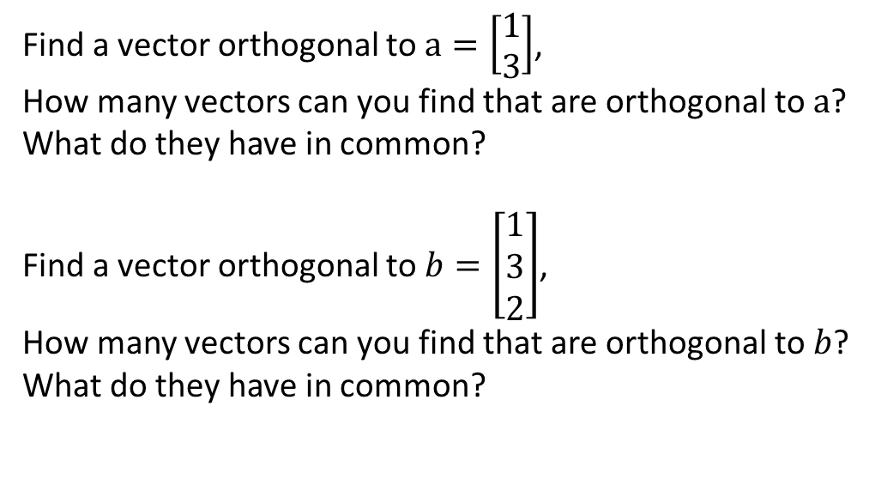
Exercise:
Find a vector orthogonal to $a=\left[\begin{matrix}1 \\ 3\end{matrix}\right]$,
How many vectors can you find that are orthogonal to $a$?
What do they have in common?
Find a vector orthogonal to $b=\left[\begin{matrix}1 \\ 3 \\ 2\end{matrix}\right]$,
How many vectors can you find that are orthogonal to $b$?
What do they have in common?
Notes:
[-3 1], but also [-6 2] or [3 -1], so c*[-3 1]
c*[-3 1 0], but also d*[-2 0 1] or e*[0 -2 3]
-3 -2 0 -3 -2 0 -3 -2 0
1 0 -2 -> 0 -2 -6 -> 0 -2 -6 3*2nd row – 1st row
0 1 3 0 1 3 0 0 0 2*3rd row – 2nd row

Slide 17
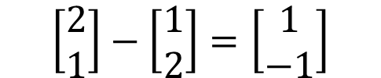


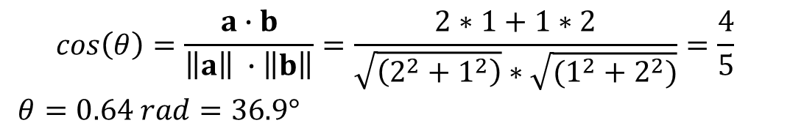
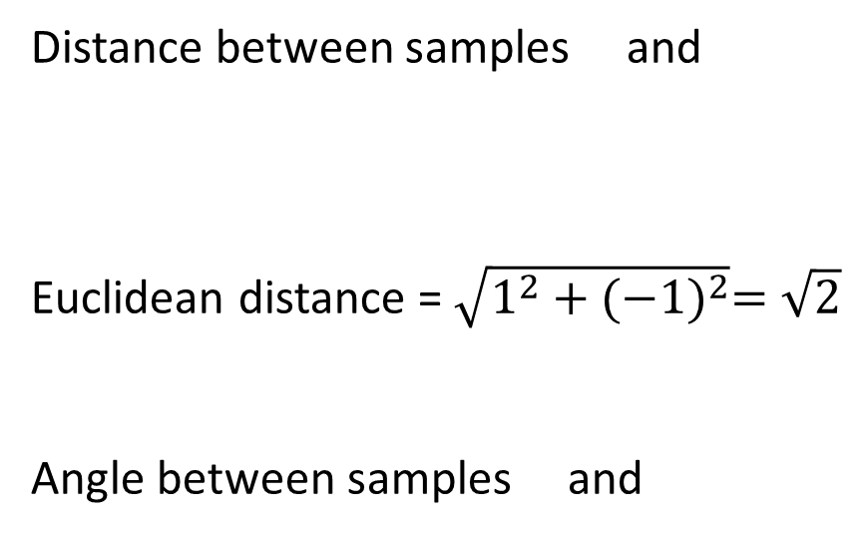
Distance between vectors: Application in clustering
Distance between samples and
Euclidean distance = $\sqrt{1^{2}+{(−1)}^{2}}=\sqrt{2}$
Angle between samples and
x₂
$$\left[\begin{matrix}2 \\ 1\end{matrix}\right]−\left[\begin{matrix}1 \\ 2\end{matrix}\right]=\left[\begin{matrix}1 \\ −1\end{matrix}\right]$$
$$\sqrt{2}$$
$$θ$$
0
x₁
$$cos\left(θ\right)=\frac{a∙b}{\left\|a\right\| ∙\left\|b\right\|}=\frac{2∗1+1∗2}{\sqrt{\left(2^{2}+1^{2}\right)}∗\sqrt{(1^{2}+2^{2})}}=\frac{4}{5}$$
$θ=0.64 rad=36.9°$
Notes:
radians

Slide 18

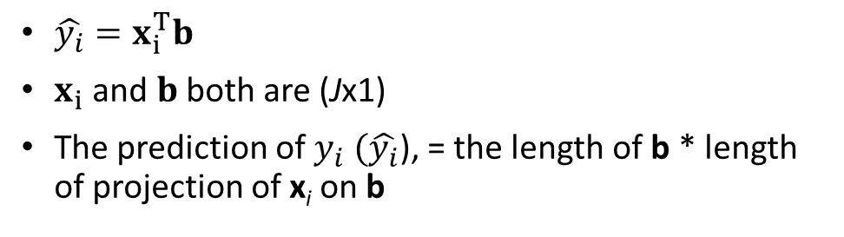

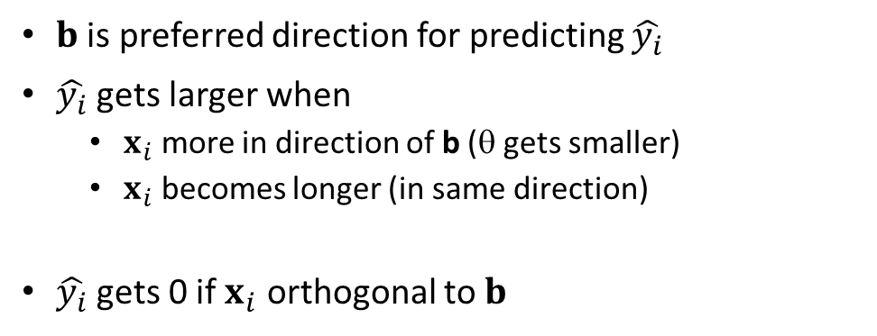
Dot product applied in regression
$\hat{y_{i}}=x_{i}^{T}b$
$x_{i}$ and $b$ both are (Jx1)
The prediction of $y_{i}$ $(\hat{y_{i}}$), = the length of b * length of projection of x_{i} on b
x_{i}
b
$$θ$$
$\hat{y_{i}}= \left\|b\right\|$ * ||projection of x_{i} on b|| = 3 * 2 = 6
$b$ is preferred direction for predicting $\hat{y_{i}}$
$\hat{y_{i}}$ gets larger when
$x_{i}$ more in direction of b (θ gets smaller)
$x_{i}$ becomes longer (in same direction)
$\hat{y_{i}}$ gets 0 if $x_{i}$ orthogonal to $b$
x_{i}
b
$$θ$$

Slide 19
Rank of a matrix
Lowest number of independent (columns or rows) present in the matrix?
4 rows, 3 columns: rank cannot be larger than 3
Note that column 3 = column 1 + column 2
This makes the rank only 2
Multiplication of a matrix cannot increase the rank
C = BA; rank(B) = 5, rank(A) = 3, then rank(C) is 3 at most!
(Chemical) Rank
With noisy data the rank is often considered to be the dimension of the systematic variation (disregarding the noise).
Notes:
All 4 samples (rows) lie in a 2-dimensional subspace in the 3-dimensional rowspace (Rank = 2)
Example: 10 mixtures of 2 compounds

Slide 20



Geometry: Rank / Subspace
Two samples (vectors) in a 3 dimensional space only cover a 2 dimensional subspace of the 3-dimensional space.
Third dimension is not filled
Matrix is not full rank
The 3D space is not fully occupied by the samples.
I < J (less samples than variables
Samples cover only a subspace of the J-dimensional space where the samples live.
Null space is space orthogonal to this subplace
Samples that are already in the same subspace do not increase the rank
[2 2 2] = 2*[1 1 1]
[4 3 2] = [3 2 1] + [1 1 1]
$$\left[\begin{matrix}3 & 2 & 1 \\ 1 & 1 & 1\end{matrix}\right]$$
x₂
x₃
x₁
$$\left[\begin{matrix}3 & 2 & 1 \\ 1 & 1 & 1 \\ 2 & 2 & 2\end{matrix}\right]$$
$$\left[\begin{matrix}3 & 2 & 1 \\ 1 & 1 & 1 \\ 4 & 3 & 2\end{matrix}\right]$$

Slide 21





Outer product of 2 vectors
The outer product of 2 vectors produces a matrix.
e.g.: a PCA score * PCA loading creates an estimate of the matrix
$\hat{X}=t_{1}p_{1}^{T}$
$\hat{X}$ is a matrix built from 1 vector * 1 vector. Its rank = 1.
All samples lie on a one-dimensional subspace.
$$p_{1}^{T}$$
$$\hat{X}$$
$$\hat{X}$$
=
$$t_{1}$$
x₂
x₁
0
Notes:
p1 is the direction of the blue dotted line. p1 has a value for X1 and for X2
Each value in t points to a different position on that line.

Slide 22
Mean-centering of a matrix
X
In PCA a first step is often to mean-center the data matrix.
This is applied to focus on variation between elements in the column (and not on its value).
Mean-centering removes the column mean from each element in the column.
Mean-centering can be applied using a matrix multiplication using the data matrix and the column mean.
X – 1m^{T}
1: column of ones (I x 1)
m: means of each column (J x 1)
-
Column means^{T}
Column of ones
=
X_{meancentered}
X – 1*column means^{T}
Notes:
Write out example of columns of ones X means

Slide 23




Product of matrix and a vector: $\hat{y}=X∗b$
$\hat{y}$(Ix1) = X(IxJ) * b(Jx1)
The result is a vector of size I
#Columns of X = #values in b
$\hat{y}=x_{1}b_{1}+x_{2}b_{2}+…+x_{J}b_{J}$
$\hat{y}$ = weighted sum of columns in X.
Each variable in X has its own coefficient in b
Contribution of variable j to prediction of $\hat{y}$comes from b_{j} AND size of values in x_{j}.
For every sample $x_{i}^{T}$this is the dot product with b.
${\hat{y_{i}}=x}_{i}^{T}b$
b
$$X$$
$$\hat{y}$$

Slide 24
Multiplication of matrices
Multiplication of two matrices is calculating inner products between all rows in A and columns in B.
C (I x K) = A (I x J) * B (J x K)
THUS:
the number of elements in each row of A is equal to number of elements in column B.
Number of columns in A = number of rows in B
?? What can you say about the rank of C?
B
X
A
C = A*B
Notes:
Rank of A is minimum of rows and columns. (or lower if they are dependent).
Rank of B is minimum of rows and columns. (or lower if they are dependent).
Rank of C is minimum of rank of A and B

Slide 25

Inverse of a matrix
Dividing by a matrix is performed by multiplying times its inverse.
$\frac{X}{X}=X∗\frac{1}{X}=X∗X^{−1}=I$; $X^{−1}∗X=I$
I = identity matrix
Inverse can ONLY be obtained when X has full rank
Identity matrix has full rank
Matrix multiplication cannot increase rank
Determinant ≠ 0
Only square matrices can have an inverse.
Explain this
X
X⁻¹
X
X
1 0 0 0 0 0
0 1 0 0 0 0
0 0 1 0 0 0
0 0 0 1 0 0
0 0 0 0 1 0
0 0 0 0 0 1
X
Identity matrix
X * X⁻¹ = I
X⁻¹ * X = I
Notes:
Number of columns of X equals number of rows in inv(X) because of the multiplication rule.
Number of rows in X equals number of columns in inv(X) because the product I is square.
As I has ones on full diagonal its rank = I. Thus also X has rank I.
AND X⁻¹ *X is also I

Slide 26


Matrix multiplication: $X^{T}∗X$
X^{T} (J x I) * X(I x J) = D(J x J)
D = symmetric of size J x J.
The diagonal contains inner product of each column of X with itself
The off-diagonals contain the inner product of a column with another column.
If X is mean-centered then: $\frac{1}{I−1}X^{T}X$ = covariance matrix
Diagonal contains variance of columns
Off diagonals contain covariance
If X is mean-centered and scaled by standard deviation?
$X^{T}X$ is correlation matrix
Diagonal = 1, off-diagonals are correlations between variables.
3
X
X
D=X^{T}X
X^{T}
7
Variable 3
Variable 7

Slide 27


Matrix multiplication:${\left(X^{T}∗X\right)}^{−1}$
Only square matrices can have an inverse
If X is not square, the X^{T}*X is often used
As X^{T}*X provides the covariance (up to a constant)
In regression $y=Xb$
$b= \frac{X^{T}y}{X^{T}X}={\left(X^{T}X\right)}^{−1}$ $X^{T}y$
Variation of X in direction y vs covariation in X
(X^{T}*X)⁻¹ is called the precision matrix
X
X^{T}
X^{T}
D = X^{T}X
Notes:
X’y is inner product of each variable in X and y

Slide 28

Problematic Example
$X=\left[\begin{matrix}1 & 2 \\ 2 & 4 \\ 3 & 6\end{matrix}\right],y=\left[\begin{matrix}3 \\ 6 \\ 9\end{matrix}\right]$
$y=Xb$; $b$ = [1,1], [3,0], [0,1.5], [2,0.5], …
Rank($X$) = ?
${b=\left(X^{T}X\right)}^{−1}X^{T}y$
$X^{T}X=\left[\begin{matrix}14 & 28 \\ 28 & 56\end{matrix}\right]$
Rank $X^{T}X$ = ?
${\left(X^{T}X\right)}^{−1} ?$
system is exactly singular:
x₂
y
x_{.2}
x_{.1}
x₁
0
Notes:
Does not matter what y is, the problem is in X
X is not full rank!
So inverse of X’X does not exist

Slide 29
Fat matrix J >> I
In many research fields, X is a fat matrix (J >> I)
Calculating (X^{T}X)⁻¹ will lead to problems: Explain why
Use dimension reduction methods to create matrix T (J < I) which is a good summary of X.
(T^{T}T)⁻¹ can be calculated without problems.
J
X
I
R
X^{T}
T
I
Notes:
Fat matrix as the number of variables >> number of samples
The rank of D is only I, but is size is J x J. So inverse does not exist
X*(X’*X)⁻¹*X’y
T*(T’*T)-1*T’Y

Slide 30
Linear Algebra: Geometry
J
X
X
I
A matrix X (I x J), connects a vector in the row space (R^{J}) to a vector in the column space (R^{I}).
X(IxJ) * r(Jx1) = c(Ix1)
X^{T}(JxI) * c(Ix1) = r₂(Jx1)
! You do not always end up in the same vector r
x₂
R^{J}
x₂
R^{I}
x_{J}
x₃
x_{I}
x₃
X
X
x₁
I
x₁

Slide 31

Multivariate Regression
y = Xb + e
Find vector b in R^{J} such that $\hat{y}$= Xb is as close as possible to y (or e is as small as possible)
Row space
Column space
R^{J}
b
x₂
$$\hat{y}$$
y
x₂
R^{I}
J
x_{J}
x₃
x_{I}
x₃
X
X
I
x₁
x₁

Slide 32
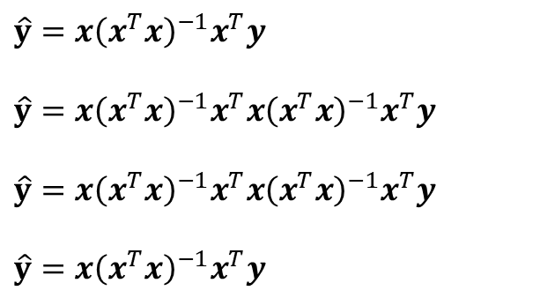
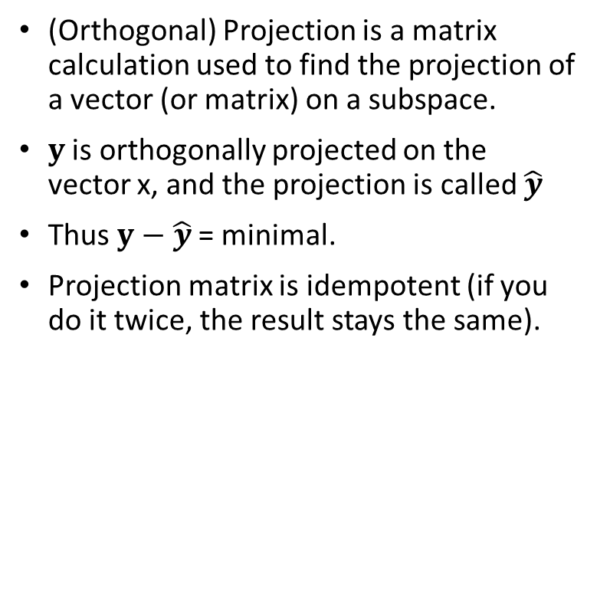
Projection
x
(Orthogonal) Projection is a matrix calculation used to find the projection of a vector (or matrix) on a subspace.
$y$ is orthogonally projected on the vector x, and the projection is called $\hat{y}$
Thus $y−\hat{y}$= minimal.
Projection matrix is idempotent (if you do it twice, the result stays the same).
b
y
$$\hat{y}=x{\left(x^{T}x\right)}^{−1}x^{T}y$$
$$\hat{y}=x{\left(x^{T}x\right)}^{−1}x^{T}x{\left(x^{T}x\right)}^{−1}x^{T}y$$
$$\hat{y}=x{\left(x^{T}x\right)}^{−1}x^{T}x{\left(x^{T}x\right)}^{−1}x^{T}y$$
$$\hat{y}=x{\left(x^{T}x\right)}^{−1}x^{T}y$$

Slide 33

Multiple Regression: column space representation
X₁,X₂ orthogonal
e
$$\hat{y}=Xb \\ b={\left(X^{T}X\right)}^{−1}X^{T}y \\ \hat{y}=X{\left(X^{T}X\right)}^{−1}X^{T}y$$
b₁
b₂

Slide 34
Centering and Scaling geometrically
Subtract mean of each column.
Centering to focus analysis on differences between samples and not how they all are different from 0.
Divide each column by its standard deviation
Scaling is performed to make spread of data in all variables comparable.
Row space
Row space
Row space
X₂
X₂
X₂
X_{J}
X₃
X_{J}
X_{J}
X₃
X₃
X₁
X₁
X₁

Slide 35
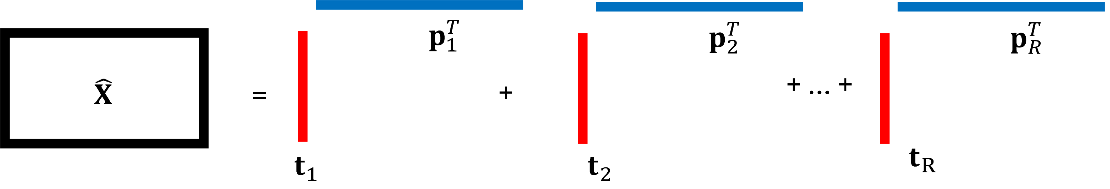
Singular value decomposition on X
Singular value decomposition provides
Left singular vectors (u₁, u₂, ..)
Right singular vectors (v₁, v₂, ..)
The outer product of each set of u and v approximate X.
Singular values, represent values how well each outer product approximates X.
Often written as
X = U*S*V^{T}
U contains all u; u^{T}u = 1
V contains all v; v^{T}v = 1
S contains all singular values on its diagonal (s₁,s₂, …)
s₁
s₂
s₃
v₁^{T}
v₂^{T}
v₃^{T}
u₁
u₂
u₃

Slide 36
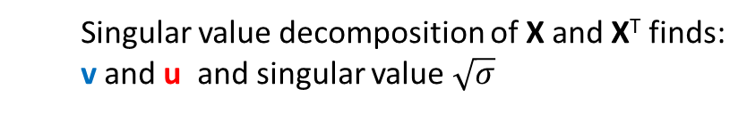
Singular value decomposition on X
Any vector in R^{J} is projected to a vector in R^{I}.
Singular vector are special vectors that project on themselves.
Row space
J
Column space
x₂
X
x₂
I
X
x_{J}
x₃
x_{I}
x₃
I
x₁
x₁
X^{T}
Find v and u vectors for which
X(IxJ) * v(Jx1) = u(Ix1)
X^{T}(JxI) * u(Ix1) = σv(Jx1)
Singular value decomposition of X and X^{T} finds:
v and u and singular value $\sqrt{σ}$
J

Slide 37
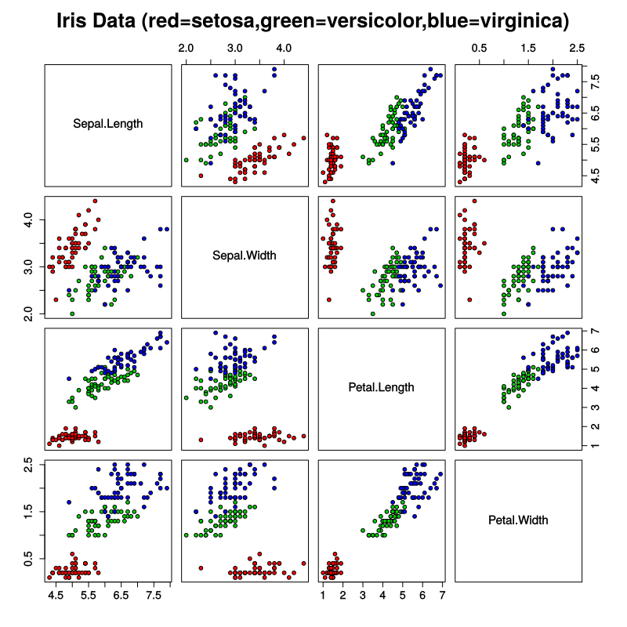
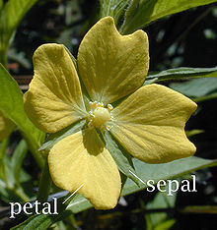
Some examples in real data (Iris)
Iris data (50 plants of three classes each)
Four features were measured from each sample: the length and the width of the sepals and petals, in centimeters.
Correlation matrix
Sepal.Length Sepal.Width Petal.Length Petal.Width
Sepal.Length 1.000 -0.1176 0.8718 0.8179
Sepal.Width -0.1176 1.0000 -0.4284 -0.3661
Petal.Length 0.8718 -0.4284 1.000 0.9629
Petal.Width 0.8179 -0.3661 0.9629 1.0000

Slide 38
Singular value decomposition of Iris data
SVD on Iris data provides u values for each iris and v values for each variable.
s₁ = 95.96
s₂ = 17.76
The first set of singular vectors approximates the iris data much better than the second set.
But together they approximate the data even better.
u₂
u₁
Sepal width
Sepal length
v₂
Petal width
Petal length
v₁

Slide 39
Iris data matrix
4
colMeans(iris):
Differences between variables
rowMeans(iris):
Differences between classes
Differences between individual plants
150

